Slide 1
Page Layout:
Layers, Tables & Frames

Slide 2
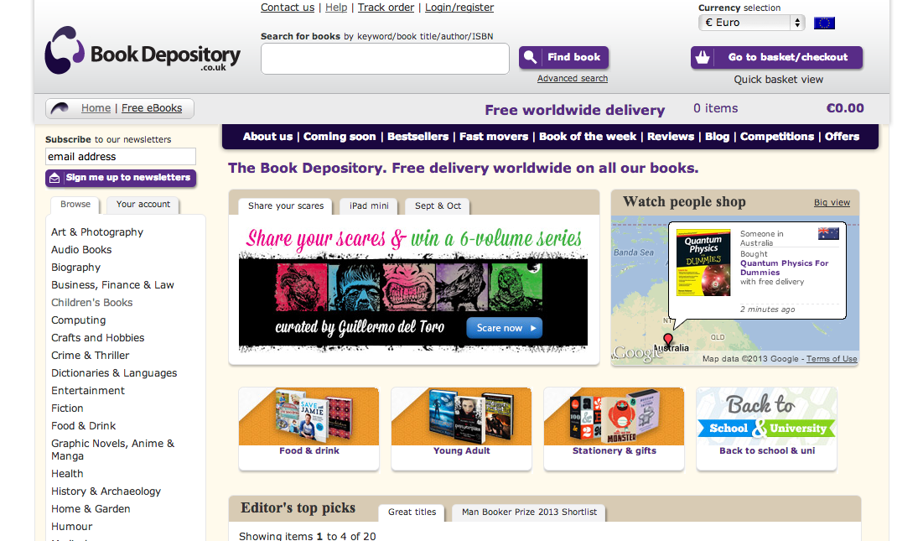

Slide 5


Slide 6
What is a Wireframe?
“The purpose of a wireframe is to communicate the layout of the page without getting caught up in colour and design elements”
Webdesignledger

Slide 7
REMINDER…
<div></div>
Layers

Slide 8
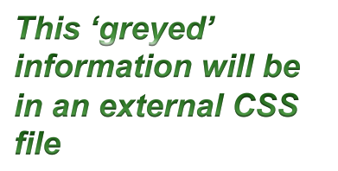
<div></div>
Description:
<div> ….</div>
Implementation:
<div style=“width:100%; height:15%; background-color:#FF7F24;" > Overview of DIT</div>
Output:
Overview of DIT
Overview of DIT

Slide 9
Layer Positioning
A layer is a rectangular container (region) that holds HTML content and can be positioned anywhere on a web page
Layer is placed using pixel coordinates/percentages
Layers organize and format page content
Initial layers can get covered by new layers

Slide 10
Layer1
Layer2
Layer4
Layer3
Layer5
Layer6
Layer7
Layer8
Layer9
Layer10

Slide 11
Properties of Layers
Some important properties are:
  id – specifies layer name, used with CSS
  location – measured relative to top left corner
  size – specifies width and the height
  visibility – specifies whether a layer is hidden or visible
  background color – a colour can be assigned to a layer
  overflow –what to do if content exceeds layer’s size

Slide 12
Nesting Layers
A nested layer is a layer inside another layer
Example: 3-level nesting
<div>
  <div>
    <div>
</div>
</div>
</div>

Slide 13
Nesting Layers
Cell 1
Cell 21
Cell 22
<div …………….>
<div ……………><b>Cell 1</b>
</div>
<div>
<div ……………….."><b>Cell 21</b>
</div>
<div …………………….><b>Cell 22</b>
</div>
</div>
</div>

Slide 14
Formatting Via Layers
Formatting via layers is based on the idea of nesting layers
Each layer can be viewed as an independent region that can hold any HTML content
The web page is divided into regions according to its layout
Each region is then substituted by a layer

Slide 15
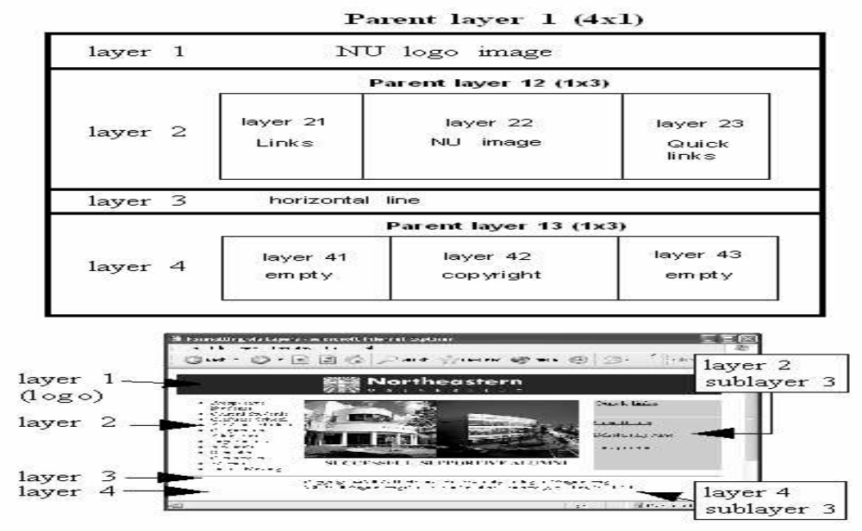
Formatting Via Layers

Slide 16

& divs
The use of the tag <div> will be reduced considerably in HTML5. We will discuss this again when learning CSS.

Slide 17


Slide 18
<table></table>
<tr></tr>
<td></td>
Tables

Slide 19
<table><tr><td></td></tr></table>
Description:
<table> <tr><td>…</td><td>…</td>
</tr></table>
Implementation:
<table> <tr><td>Cell 1</td><td>Cell 2</td>
</tr></table>
Output:
Cell 1 | Cell 2

Slide 20
Table
Tables are used on Web pages in two ways:
  To organise information
  To format the layout of an entire Web page

Slide 21
Tables
A table is defined as a region that has rows and columns of small rectangles, called cells, that are arranged relative to each other in a certain way that makes up the table layout
Web pages that use tables are harder to code

Slide 22
Tables Structure & Variables
HTML provide many variables that allow web authors to control table structure
Table variables may be grouped into 2 categories:
  Non-cell variables
  Cell variables

Slide 23
Non Cell Variables
Non cell variables control the properties and structure of the table, not the actual contents of the table:
  caption is the title of the table
  summary provides a longer description
  border is the table’s outside border
  header is the first row of the table
  rows are the horizontal layout of the cells
  columns are the vertical layout of the cells
  width is a representation of the number of columns
  height is a representation of the number of rows

Slide 24
Non Cell Variables
Border
Heading 1
Heading 2
Heading 3
Cell(1,1)
Cell(1,2)
Cell(1,3)
Cell(2,1)
Cell(2,2)
Cell(2,3)
Height
Cell(3,1)
Cell(3,2)
Cell(3,3)
Cell(4,1)
Cell(4,2)
Cell(4,3)
Rows
Cell(5,1)
Cell(5,2)
Cell(5,3)
Cell(6,1)
Cell(6,2)
Cell(6,3)
Cell(7,1)
Cell(7,2)
Cell(7,3)
Columns
Width

Slide 25
Cell Variables
Cells are the basic units that make up the table
Cell variables control the properties and structure of individual cells:
  Row span
  Column span
  Padding
  Spacing
  Alignment

Slide 26
Cell Variable: colspan
<table border="1">
<tr>
<td colspan=“2”>
Birthday List</td>
</tr>
<tr>
<td>James</td>
<td>11/08</td>
</tr>
<tr>
<td>Karen</td>
<td>4/17</td>
</tr>
</table>
Birthday List
James | 11/08
Karen | 4/17

Slide 27
Cell Variable: rowspan
<table border="1">
<tr>
<td rowspan=“2>
<img src=“cake.gif” alt=“cake” height=“100” width=“100” /></td>
<td>James</td>
</tr>
<tr>
<td>11/08</td>
</tr>
</table>
 | James
 | 11/08

Slide 28
Cell Variables
Cell spacing describes the amount of the horizontal and vertical spacing between cells
Specifying cell padding is equivalent to specifying top, bottom, left and right margins for the cell
Cell content can be aligned within each cell

Slide 29
Using Tables (some tags)
<table> tag
  Contains the table
  Common attributes: border, width, align
<tr> tag
Contains a table row
<td> tag
Contains a table cell
<caption> tag
Assigns a title to a table

Slide 30
Using Tables
<table border="1">
<tr>
<td>Name</td>
<td>Birthday</td>
</tr>
<tr>
<td>James</td>
<td>11/08</td>
</tr>
<tr>
<td>Karen</td>
<td>4/17</td>
</tr>
<tr>
<td>Sparky</td>
<td>11/28</td>
</tr>
</table>
4 rows
Name | Birthday
James | 11/08
Karen | 4/17
Sparky | 11/28

Slide 31
Using Tables
<table border="1">
<tr>
<th>Name</th>
<th>Birthday</th>
</tr>
<tr>
<td>James</td>
<td>11/08</td>
</tr>
<tr>
<td>Karen</td>
<td>4/17</td>
</tr>
<tr>
<td>Sparky</td>
<td>11/28</td>
</tr>
</table>
Using the <th> Element
Name | Birthday
James | 11/08
Karen | 4/17
Sparky | 11/28

Slide 32
Nesting Tables
Table nesting is used to control formatting
Code is quite complex
A table is nested by having a table inside another table
Tables can be nested by using a <table> tag after <td>
Nesting tables may produce awkward results
  Table cell sizes may vary greatly
  Location of empty cells may not be acceptable to web authors

Slide 33
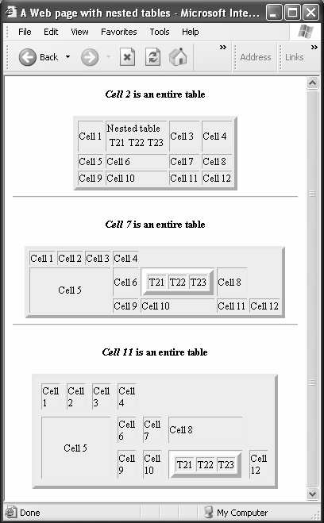
Using tables
<table>
<tr>
<td>Cell 1</td>
<td>Nested Tables<table rows="2" cols="3" align="center">
<tr>
<td>T11</td> <td>T22</td> <td>T33</td>
</tr>
</table></td>
<td>Cell 3</td>
<td>Cell 4</td>
</tr>
<tr>
<td>Cell 5</td>
<td>Cell 6</td>
<td>Cell 7</td>
<td>Cell 8</td>
</tr>
<tr>
<td>Cell 9</td>
<td>Cell 10</td>
<td>Cell 11</td>
<td>Cell 12</td>
</tr>
</table>

Slide 34
Formatting a Web Page via Tables
Formatting web pages using tables has the same idea as that of nesting tables
A web page layout is divided into regions
Then a table or a cell is substituted for each region
Even formatting web pages using tables can involve the use of nested tables

Slide 35
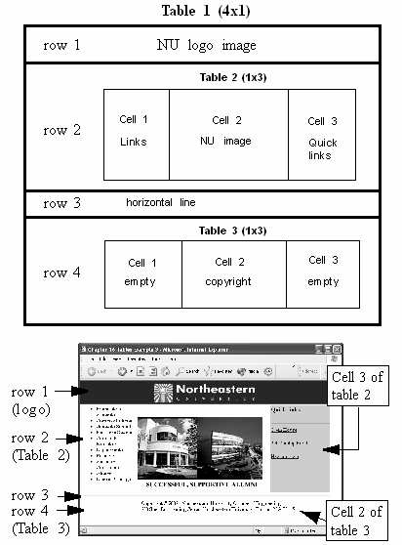
Formatting a Web Page via Tables

Slide 36
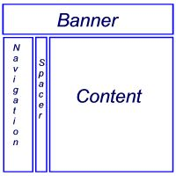
Another Example …
<table border="0" width="80%">
<tr>
<td colspan="3">
<h2>This is the banner area</h2>
</td>
</tr>
<tr>
<td width="20%" valign="top">
Place Navigation here</td>
<td width="10">&nbsp;</td>
<td>Page content goes here</td>
</tr>
</table>

Slide 37
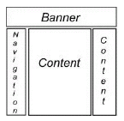
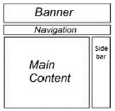
Additional Table Layouts
Can you write the code for these 2 tables?

Slide 38
Use tables (instead of layers) to structure the following page

Slide 39
Layer
Layer
Layer
Layer
Layer
Layer
Layer
Layer
Layer
Layer

Slide 40
Layers & Tables
Layers are simple to use and less restrictive
Layer nesting is simpler than table nesting
Tables use 5 tags for hierarchical structure whereas Layer just uses 1 tag for everything
Layers provide better control over formatting and layout

Slide 41
<iframe>
Frames

Slide 42
Frames
Frames divide a browser window into regions, with each region having its own web page

Slide 43
Are Frames used?
Frames are obsolete in HTML5
Frames are not encouraged in XHTML
iFrames are used in both XHTML & HTML5

Slide 44
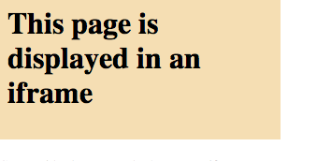
<iframe></iframe>
Description:
<iframe …………./>
Implementation:
<iframe src=“demo_iframe.htm” frameborder=“0”></iframe>
Output:

Slide 45
Using iFrames
The <iframes> tag creates inline frames
An inline frame is a frame that is embedded inside the content of a Web page

Slide 46
Using iFrames
<iframe> - Creates an inline frame
  Attributes : name, src, width, height, align, scrolling, frameborder, longdesc, marginwidth, marginheight

Slide 47


Example Uses of iFrames
Google AdSense
Embedded Youtubes

Slide 48

& iframes
New attributes are (from w3schools):

Slide 49
& frames
Frames are deprecated

Slide 50
References
Terry Felke-Morris (2013), Web Development and Design Foundations with HTML
Steven M. Schafer (2005), HTML, CSS, JavaScript, Perl, and PHP Programmer's Reference, Hungry Minds Inc,U.S.
Ibrahim Zeid (2004), Mastering the Internet, XHTML, and Javascript

